Slide 1


Practical Statistics
Part 2: Building a toolkit

Slide 2




Intro
Henry Häkkinen
Post-Doc studying the effects of climate change on seabirds and how to plan effective conservation. Latterly branched out into impacts of renewable energy on biodiversity.

Slide 3

PART 0: Recap of Session 1
We covered basic statistical theory
Normal distribution
Student’s t-distribution
Running t-tests, chi-squared tests, linear regression
Residuals and model fit
Understanding and interpreting output (estimates, p-values, etc.)

Slide 4
In this session…
Building on the skills from part 1
Creating a statistical toolkit
More distributions and GLMs
Mixed effects, and other common model extensions
Non-parametric models
Model fit and model comparisons
Expanding horizons: Other frameworks for looking at problems
Work through examples in R.

Slide 5


What is not in this session…
Lots of mathematics
Detail on lots of individual tests
Comprehensive coverage of all statistical concepts.

Slide 6

PART 1: Generalised Linear Models
Source: https://www.kristakingmath.com/

Slide 7
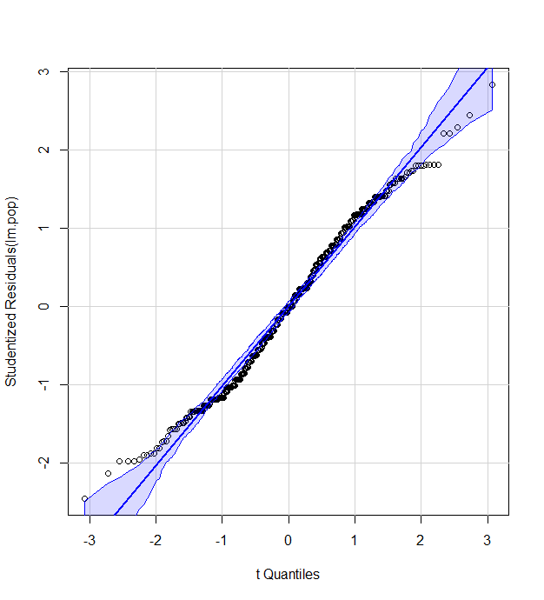
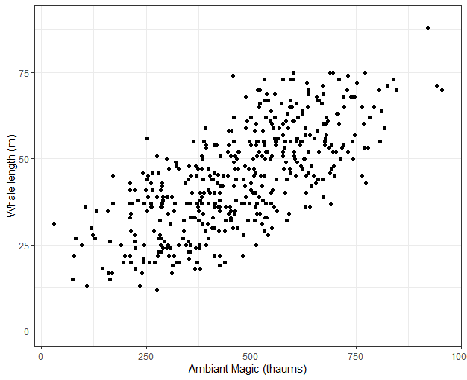
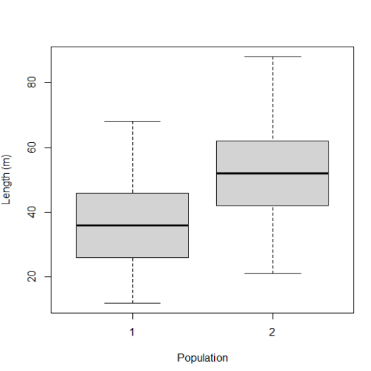
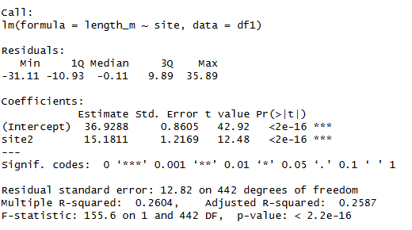
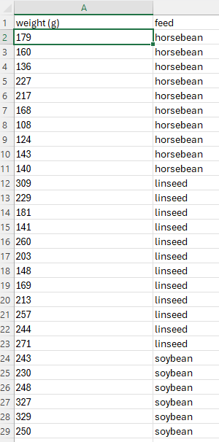
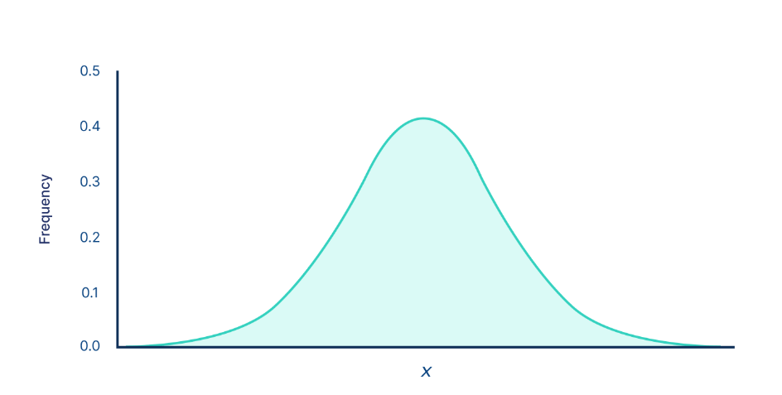
Formula: y ~ x + group
Null: “there is no difference between different groups/sites/treatments” – “there is no significant correlation between x and y”

Slide 8
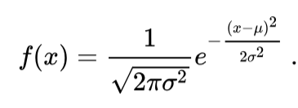
Data distributions: normal
Normal (aka Gaussian) distribution
Continuous response variable:
Weight of population
Time of migration arrival
Intelligence
Two parameters: mean (µ) and standard deviation (σ)
Link function: none (identity)
y_{i} ~ a + b₁x_{1,i} + b₂x_{2,i} …

Slide 9
Data distributions: normal
Normal (aka Gaussian) distribution
Two parameters: mean (µ) and standard deviation (σ)
Link function: none (identity)
y_{i} ~ a + b₁x_{1,i} + b₂x_{2,i} …

Slide 10
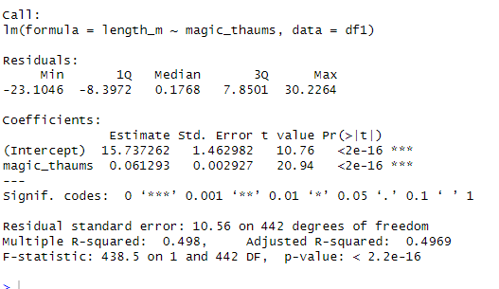
Data distributions: normal
Normal (aka Gaussian) distribution
Two parameters: mean (µ) and standard deviation (σ)
Link function: none (identity)
y_{i} ~ a + b₁x_{1,i} + b₂x_{2,i} …

Slide 11
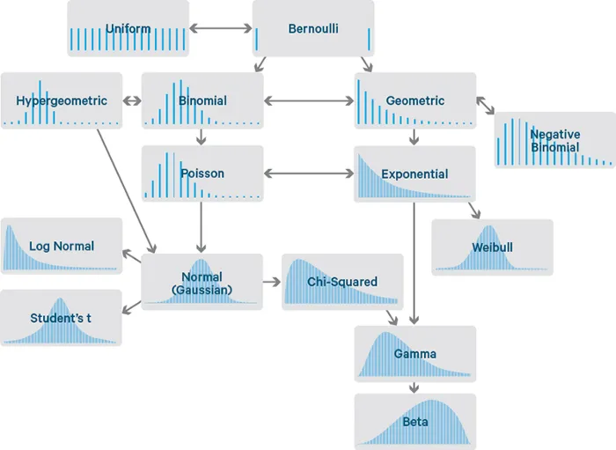
What is a Generalised Linear Model
Previously we have spoken about tests and their differences.
Different types of response variables sometimes require different distributions
Continuous
Count
Categorical (ranked/unranked)
Binary
Luckily, there is a general solution, named GLMS.
All GLMs work the same way, they just have different underlying distributions!

Slide 12
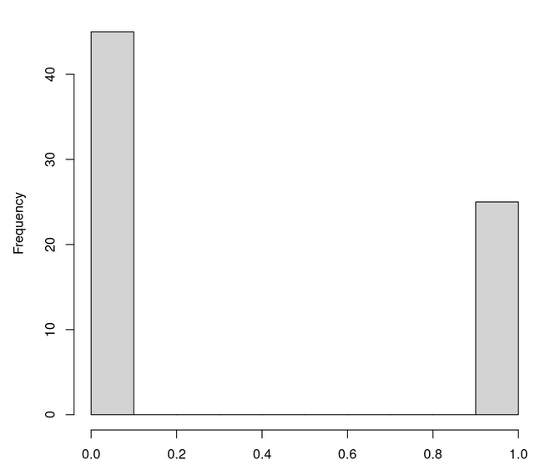
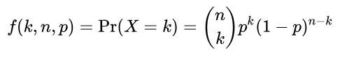
Data distributions: binomial
Binomial distribution
Binary response variable (either 0 or 1):
Species presence/absence
Survival
Disease occurrence
Two parameters: number of trials (n) and probability of success (p).
Link function: logit or log
logit(p _{i}) ~ a + b₁x_{1,i} + b₂x_{2,i} …

Slide 13
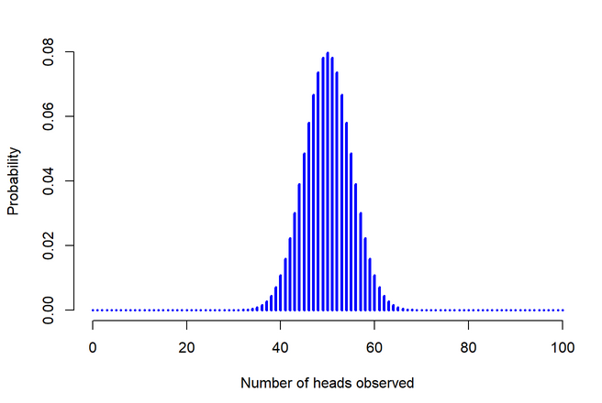
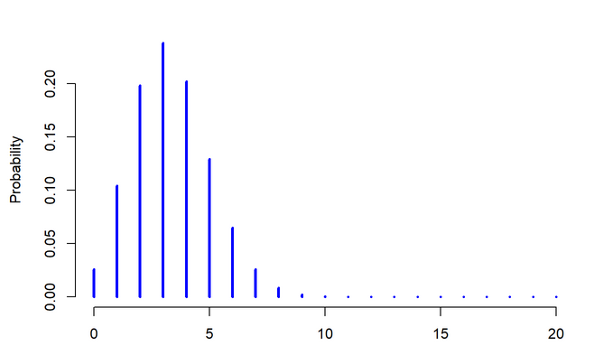
Data distributions: binomial
Binomial distribution
Data example: Does local availability of water and topography predict presence of mites?
Response variable: mites (0/1)
Predictor variables:
Water availability (continuous)
Topography (categorical)

Slide 14
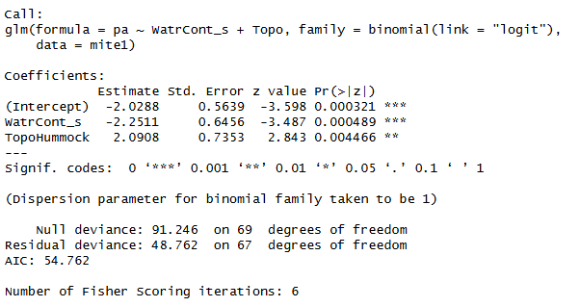
Data distributions: binomial
Link function: logit or log logit(p _{i}) ~ a + b₁x_{1,i} + b₂x_{2,i} …

Slide 15
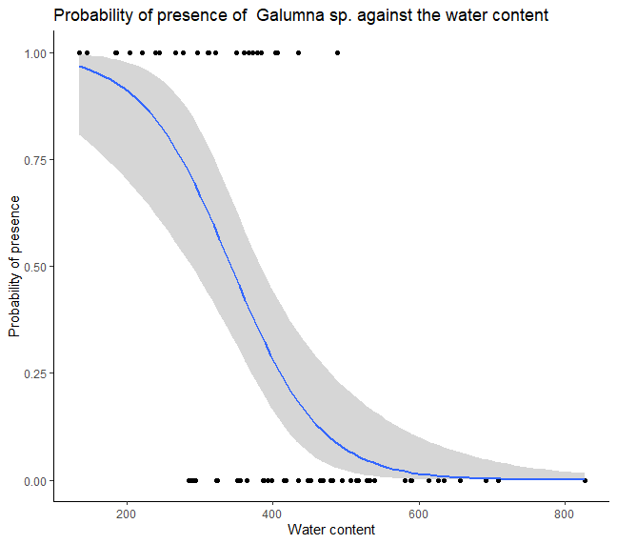
Data distributions: binomial
Many GLMS can be difficult to interpret just based on raw output.
Always remember estimates are on the link function scale!
Plotting is the easiest way to work out what is going on

Slide 16
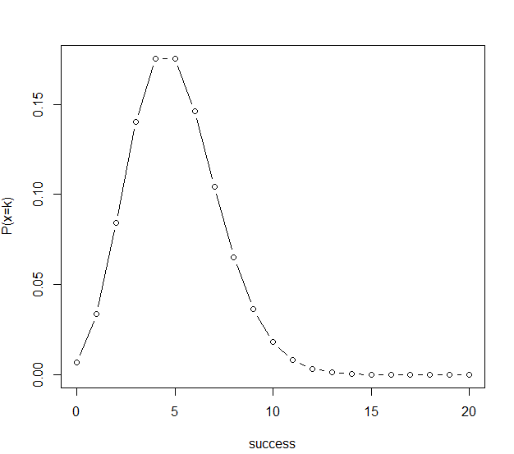
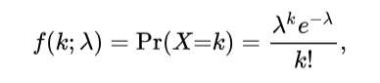
Data distributions: count data
Poisson distribution
Count response variable (where events are relatively rare):
Number of sightings
Number of mutations on a strand of DNA
Number of extreme climate events per year
One parameter: Number of events that occur in a fixed time (λ)
Link function: log or logit
log(λ_{i}) ~ a + b₁x_{1,i} + b_{2,}x_{2,i} …
Very simple, but very restrictive! Often fails to fit data

Slide 17
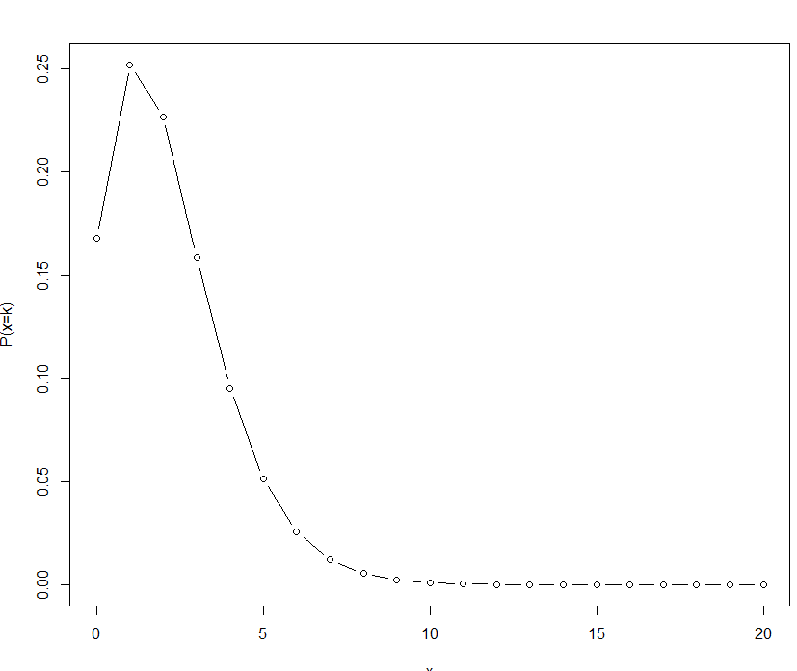
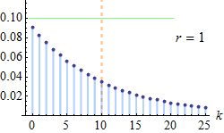
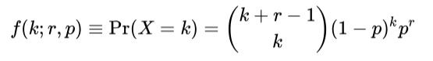
Data distributions: count data
Negative Binomial distribution
Count response variable:
Species abundance
Parasite load
Number of precipitation events
Two parameter: Number of events (r), and probability of event occurring (p)
Link function: log or logit
log(y) ~ a + b₁x + b₂x …
Much more flexible than Poisson!

Slide 18
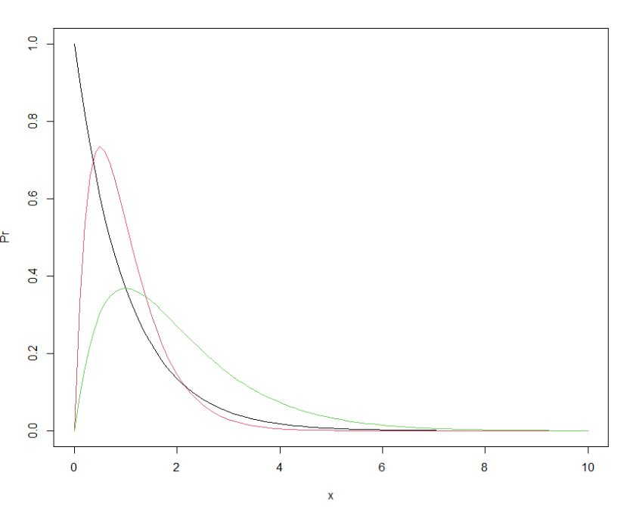
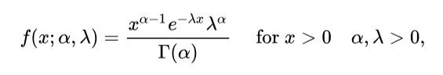
Data distributions: gamma
Gamma distribution
Used for positive continuous data, but with a skew
Basically, anything that you would use a normal distribution for, but with a strong skew!
Two parameters: shape (α) and scale (θ). 1/θ is known as the rate (λ)
Link function: negative reciprocal
-y⁻¹ ~ a + b₁x + b₂x … + ϵ
Drawback: non-intuitive and difficult to interpret residuals

Slide 19
And so on…
+ Modifications!
Quasi-
Zero-inflated
Inverse
Mixture distributions
Source: https://awstip.com/statistical-probability-distributions-89398c4b68c7

Slide 20
Statistical Models: General Approach
Steps to making a statistical test:
Think about our study system, identify our response and our predictors and make a formula
Make plots of our data (especially our response variable), and select a distribution.
Check our data fulfils the assumptions of the distribution
Run chosen statistical test (or possibly several from a shortlist)
Check the diagnostics and residuals
Consider alternative distributions if necessary
Interpret our output

Slide 21

Questions

Slide 22
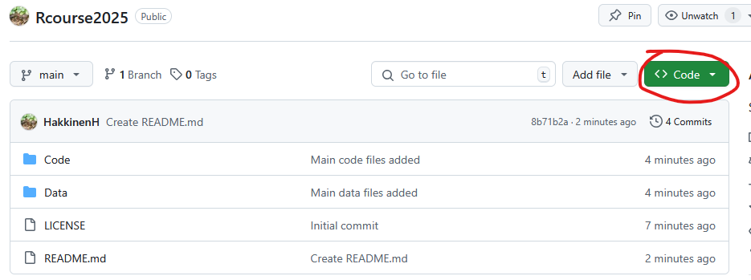
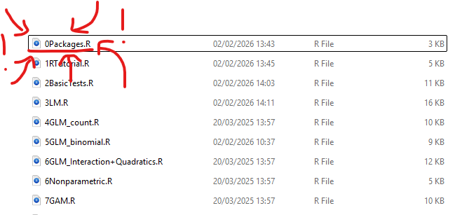
The Practical: Part 1 https://github.com/HakkinenH/RStatsCourse2026
Code -> download ZIP -> Unzip and put somewhere useful
Run 0Packages.R first ((if you haven’t already) to install packages
There are a number of example GLMs and exercises, work through them in whatever order you like:
3LM.R (GLM with normal distribution)
4GLM_count.R (Poisson/Quasipoisson/NB)
5GLM_binomial (binomial)

Slide 23

Part 3: GLM extensions

Slide 24
Statistical Models: Bells and Whistles
Sometimes additional features are needed to adequately model your data
These are optional extensions, you may never need to use them but it is useful to know they exist
They do NOT change any of the principles we have already spoken about.
I often build a basic model, find the right distribution, test it, THEN add additional complications
Complexity does not necessarily mean the model is good! If in doubt, keep it simple!

Slide 25
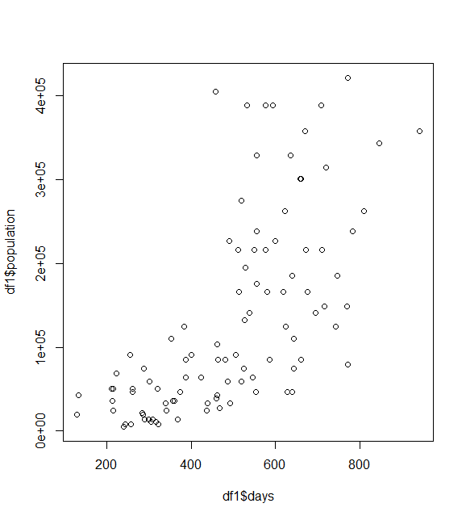
Extension 1: Transformations
Non-linear data can sometimes be transformed to fit a normal distribution
If measurements show extreme skew, or show extreme heteroskedasticity (variance increases or decreases over x), then sometimes transformation can be the easiest solution
Examples include:
Logarithms
Square root
Inverse (1/x)

Slide 26
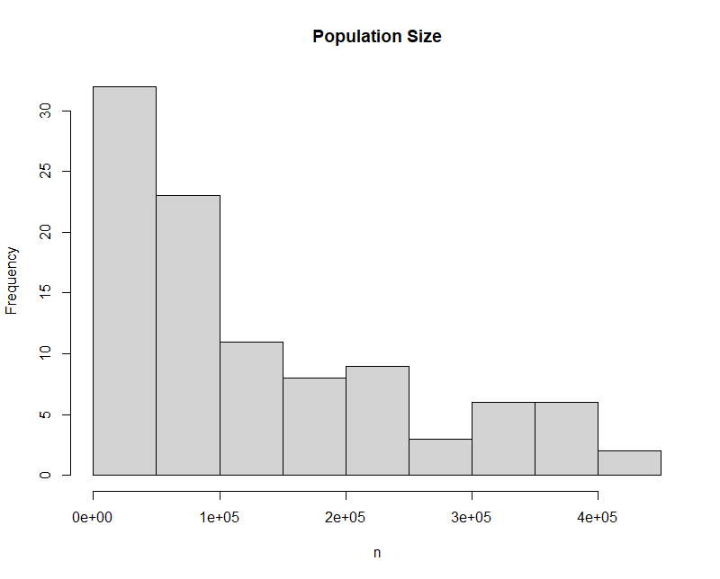
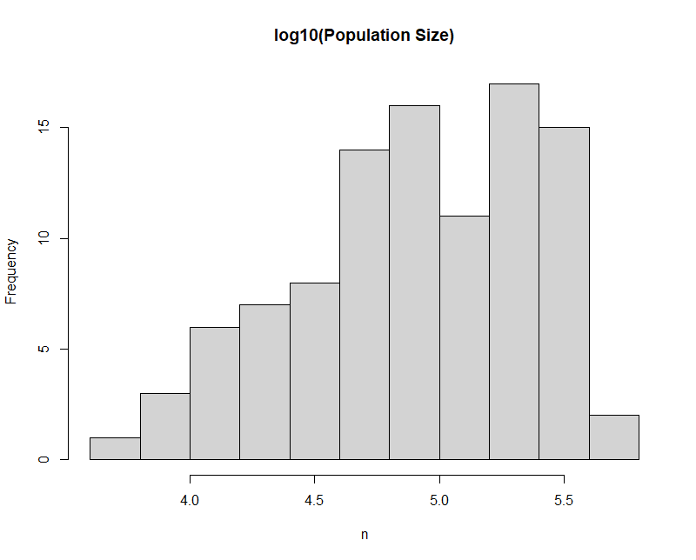
Extension 1: Transformations

Slide 27
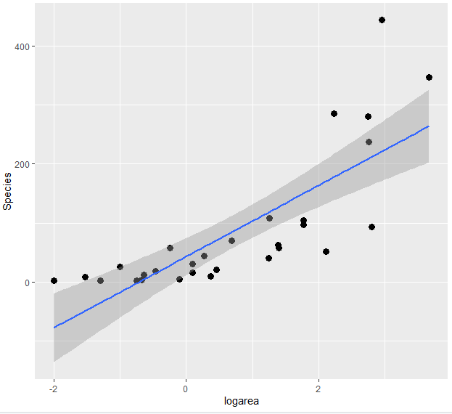
Extension 2: Quadratics
Sometimes a relationship is not linear, it is curved. What can we do in this case?

Slide 28
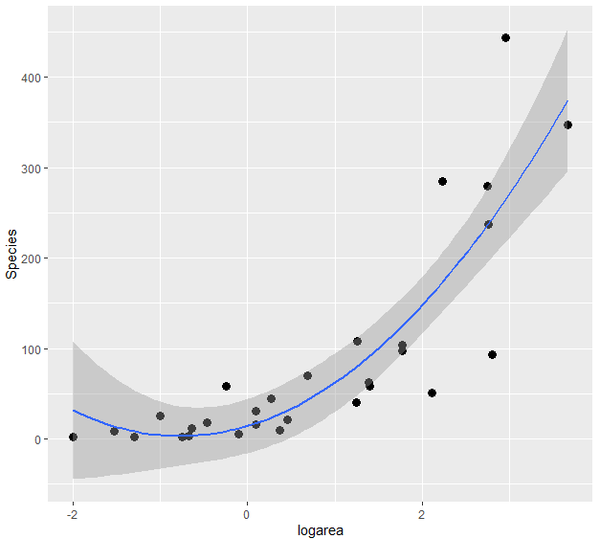
Extension 2: Quadratics
Sometimes a relationship is not linear, it is curved. In such cases we add polynomials (such as quadratics)

Slide 29
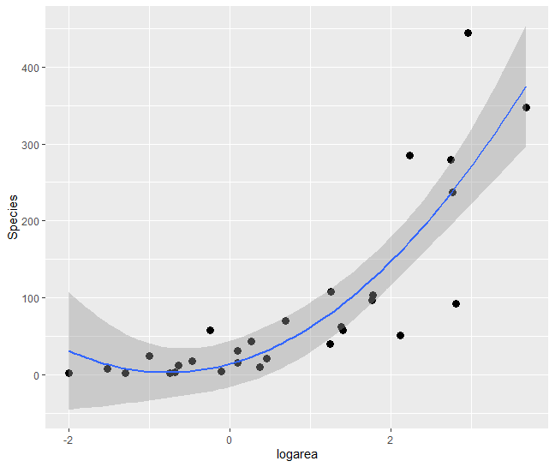
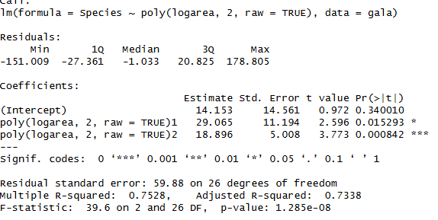
Extension 2: Quadratics
Example of quadratic output:

Slide 30
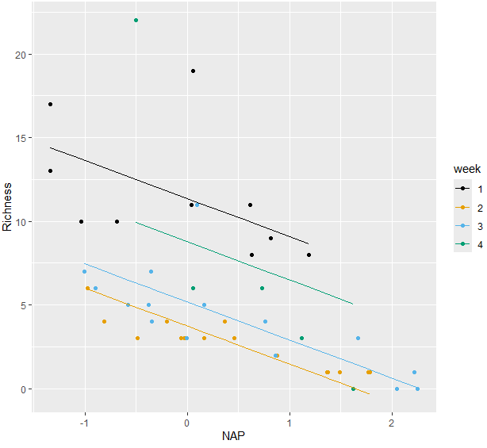
Extension 3: Interactions
When a model has a continuous and categorical predictor, we estimate the slope and the intercept separately. I.e. the slope is consistent across all categories, but the intercepts vary

Slide 31
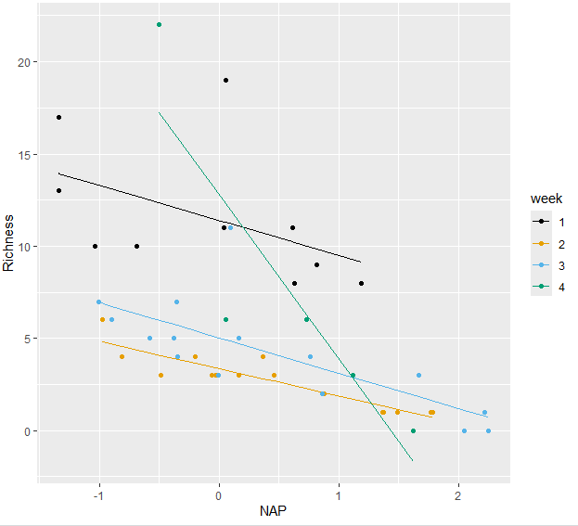
Extension 3: Interactions
Sometimes the effect of one variable is dependent on the value of another
In this case we add an interaction term to account for this

Slide 32
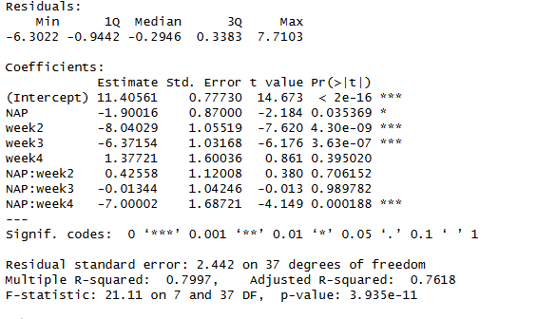
Extension 3: Interactions
Example of interaction output:

Slide 33
Extension 4: Random Effects
In ecology, sometimes our observations are not independent.
For example:
You want to test whether canopy cover reduces salamander larval density. You survey 10 ponds, 5 quadrats in each. The problem is each pond likely has unmeasured features (e.g., water chemistry, predators), and you have repeatedly measured in each pond. This is a form of pseudo-replication, and introduces various issues of bias and inaccuracy.
The solution to uneven or unstructured measurements are random effects models (aka GLMM)

Slide 34
Extension 4: Random Effects
When should you use a mixed effect models (i.e. a model with fixed and random effects)?
You don’t have to! Often there are other solutions
But they are useful when:
there are repeated measures on the same sample units (same site, same animal, same lake)
the data are naturally clustered or hierarchical in nature (e.g., you are collecting data on individuals that live in packs within multiple populations).
you are interested in quantifying variability of a response across different levels of replication (e.g., among and within lakes, among and within sites, etc)
Mixed effect models can be complex, if they are a total headache consider finding other solutions (e.g. try a Bayesian approach)

Slide 35
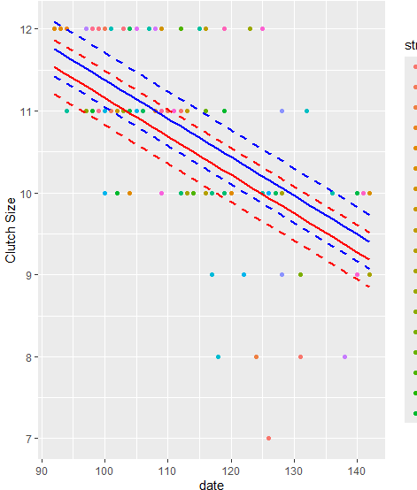
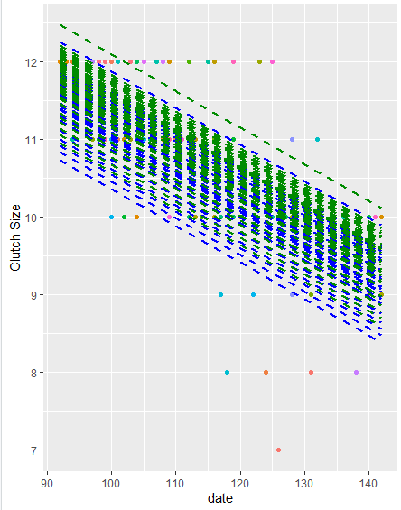
Extension 4: Random Effects
On the left we see average predictions across two categories. This is good, but some of these observations are repeated from the same sites. This is unstructured and we can’t include it as a fixed effect variable. To account for this noise, we will add site as a random effect (right)
We see a lot of signal in the data is due to the random effect of site. Happily, even after controlling for it, we still see a significant slope.

Slide 36
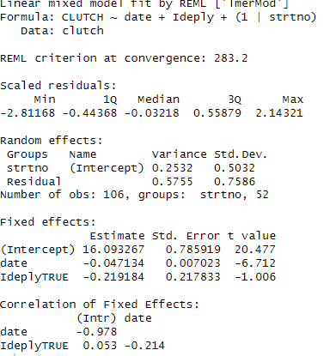
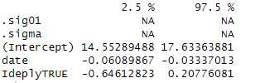
Extension 4: Random Effects
On the left we see average predictions across two categories. This is good, but some of these observations are repeated from the same sites. This is unstructured and we can’t include it as a fixed effect variable. To account for this noise, we will add site as a random effect (right)
We see a lot of signal in the data is due to the random effect of site. Happily, even after controlling for it, we still see a significant slope.

Slide 37
Extension 5: Spatial Autocorrelation
When you have spatial data, linear models assume that observations are independent
With autocorrelation, sites that are close together are more likely to be similar
This breaks a key assumption of our model
We can control for this by adding a spatial term to our model
Conceptually similar to random effects, we are controlling for non-independence in observations
This is complex and should only be done if we think we need it
Luckily we can test for spatial autocorrelation by looking at our model residuals with a variogram

Slide 38
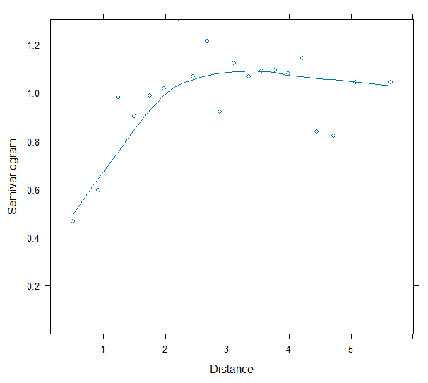
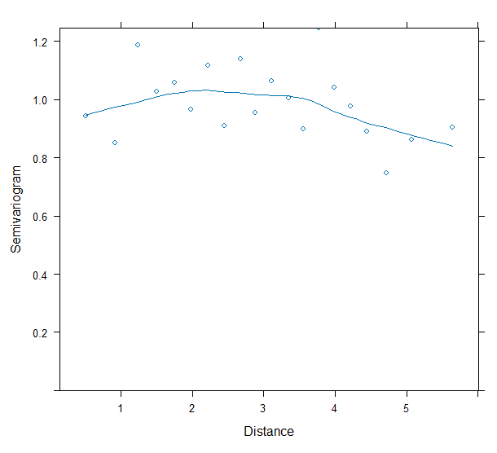
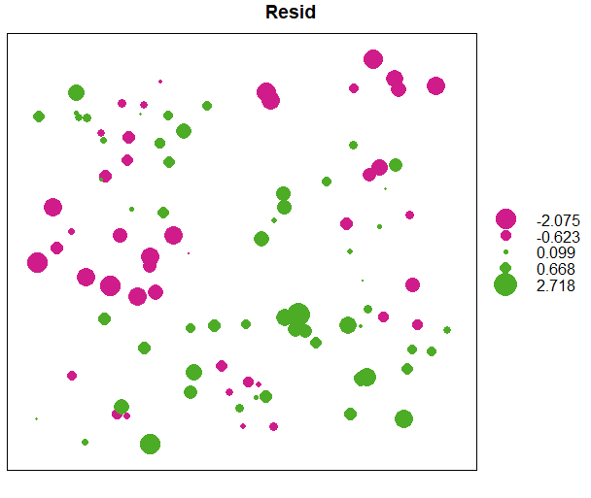
Extension 5: Spatial Autocorrelation

Slide 39

And so on…
Implementing each one of these is simply learning one more “add-on” for your model. They do not substantially change how they work.

Slide 40
Questions?

Slide 41
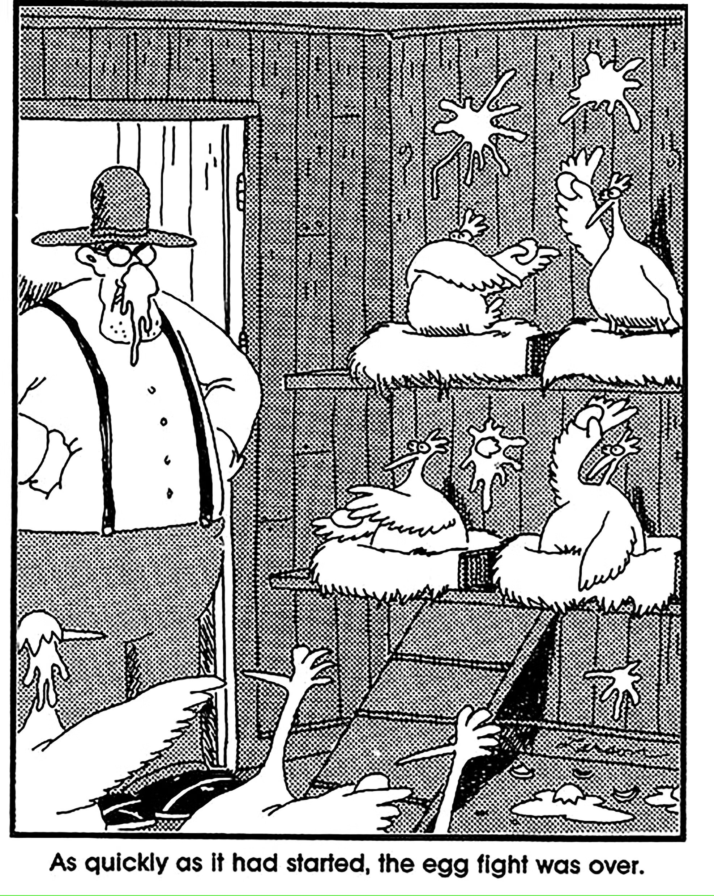
PART 3: Moving past GLMs

Slide 42
Statistical Models
Question: what do we do if no model fits properly?
Notes:
Activity: ask for answers from the room

Slide 43
Statistical Models
Question: what do we do if no model fits properly?
We have a lot of options!
Look again. R has a lot of distributions implemented, one of them might work
Try a data transformation? Could a square root, a log, a logit transformation help (note: use this as a last resort, it’s better to use native data)
Get more complicated. Some issues can be solved by adding more parameters and corrections (e.g. quadratic parameters), or by bootstrapping.
Use a non- or semi-parametric approach!

Slide 44
Non-parametric model
A very useful alternative when no other approach works.
Requires no distribution, makes no assumptions about data
BUT less powerful, cannot model interactions or other complex parameters.
Every parametric test has a non-parametric equivalent. But they all basically work the same way. For some reason they all have complicated names.
Paired t-test → Signed-rank test
2-sample t-test -> Mann-Whitney test
ANOVA → Kruskal-Wallis test
Linear regression → Spearman rank correlation (in some cases)

Slide 45
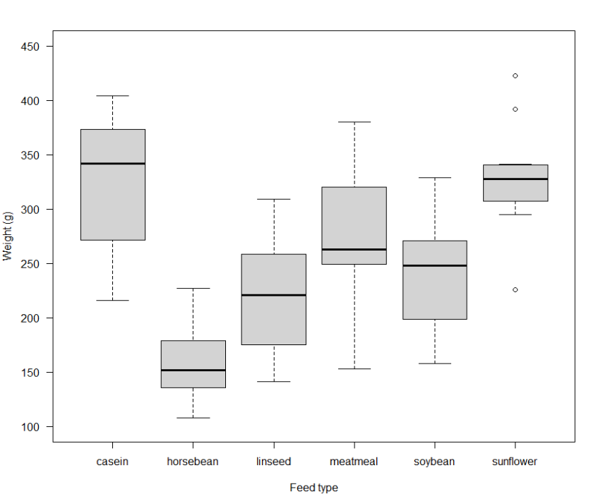
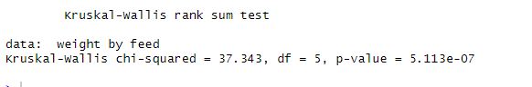
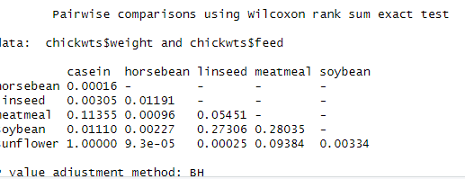
Non-parametric models
Example: for this dataset we could use a linear model (ANOVA), as we have a continuous response and categorical predictor. But if it’s not normally distributed, we can try the equivalent non-parametric test.

Slide 46
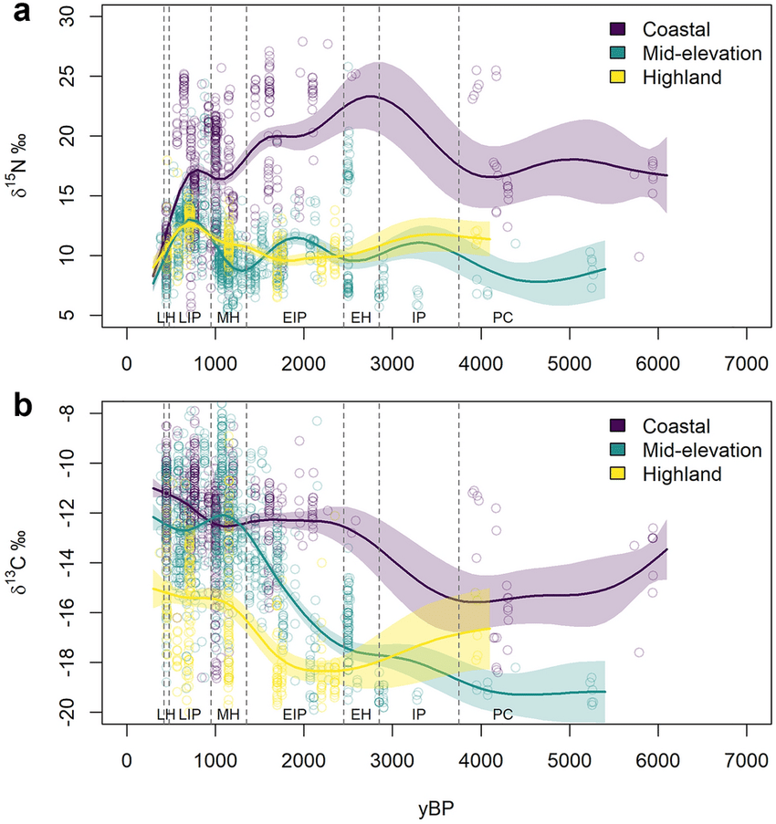
Semi-parametric models:
Combines properties of parametric and non-parametric models
Most commonly used are Generalised Additive Models
Very flexible, very useful for non-linear relationships
Especially for those that don’t fit into a standard distribution
BUT predictions are difficult and very prone to over-fitting
Interpretation is also difficult, as few concrete parameters are returned
Helpfully if data fits a parametric distribution, a GAM will just resolve to that.
Source: https://www.nature.com/articles/s41598-022-05774-y

Slide 47
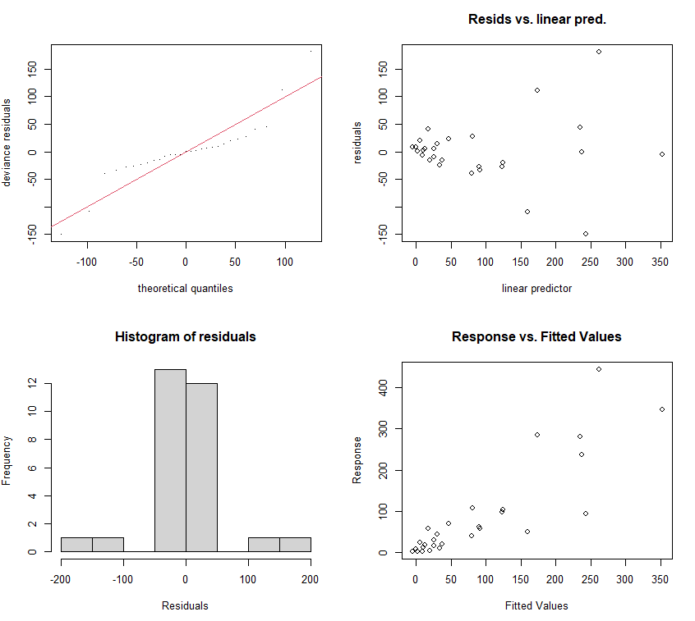
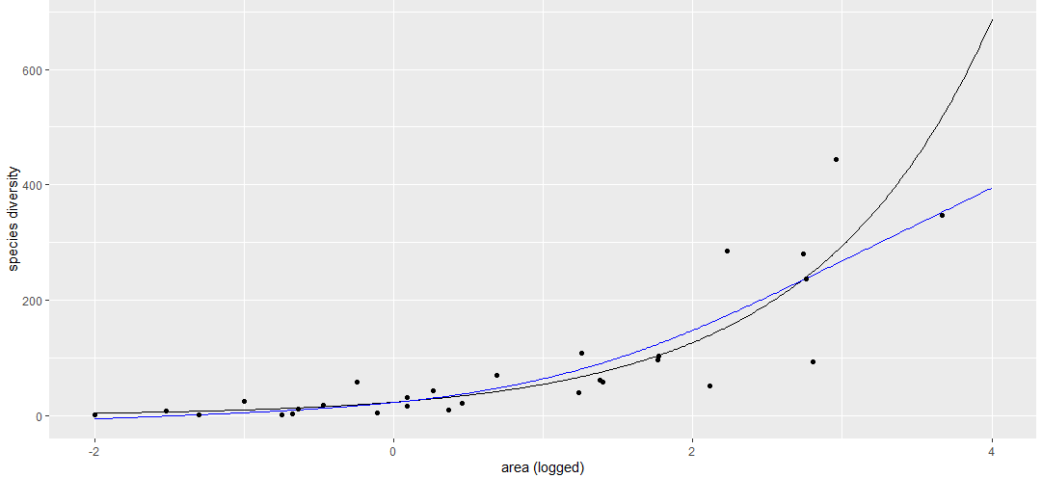
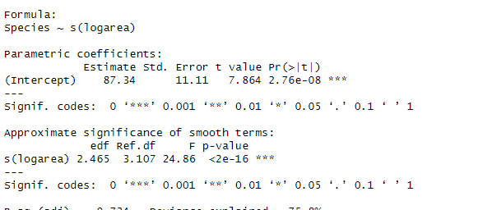
Generalised Additive Models
Based on “smoothing splines”, with two parameters
f′′(x) is the second derivative of f(x) (the main expression) and describes how smooth the curve is (high values are indicative of a lot of ‘wigglyness’),
λ is a tuning parameter that determines the penalty for `smoothness’. As λ→∞, the line will approach being completely straight
Still produce residuals, which should be checked in the same way as for other models
P-values should be interpreted with caution! They tend to be under-estimated

Slide 48
Summary: Parametric versus Non-parametric
Parametric models require you to make a choice on how the system works. Good practice as it makes you really think about the data.
Parametric models have more constraints, are more complicated, and more prone to error
BUT when they work, they are more powerful, and much more useful for building predictions
Non/semi-parametric models nearly always work, they are very flexible
They have many fewer assumptions, and it is difficult to generate errors with them
BUT they are less powerful, prone to overfitting, and can be very difficult to interpret or predict with.
A dark secret method: run both and make sure they give you a similar answer. If they don’t then something is likely wrong.

Slide 49
Questions?

Slide 50
The Practical: Part 2 https://github.com/HakkinenH/RStatsCourse2026
Code -> download ZIP -> Unzip and put somewhere useful
Run 0Packages.R first ((if you haven’t already) to install packages
Work through files 6 to 11, in whatever order you like!

Slide 51
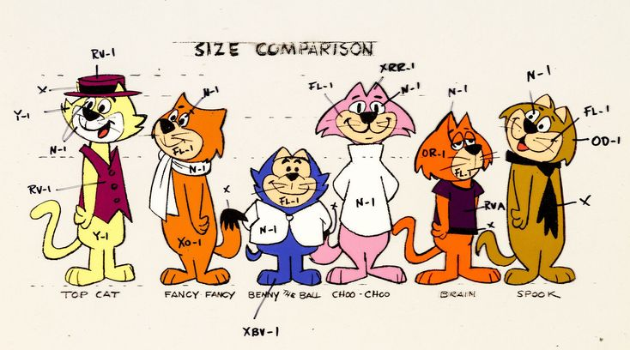
PART 5: Model fit and model comparisons

Slide 52
Model fit and model comparisons
It is possible you will end up with some competing models at the end of your analysis.
E.g. some might have interactions, some might not. Some might have quadratics, some might not.
How do you decide which one is “best” is they all fit ok (i.e. residuals look fine)?
This is where model fit and model comparison come in

Slide 53
Option 1: put everything in the model
Include every potential predictor variable, every interaction, every quadratic function you can think of in a model
ISSUES:
Interpretation. With so many variables, how can you make useful predictions? What do all those interactions mean?
Overfitting. Models need data to fit correctly, they need flexibility to select the best output (referred to as degrees of freedom). Having too many parameters negates this process, producing a poor model
As a general rule of thumb, you need 10-20 data points for every “event” per variable.

Slide 54
Option 2: Comparing models
You can compare models by using likelihood and information tests.
ANOVA
Likelihood-ratio tests
AIC/AICc/BIC etc.

Slide 55

Option 2: Comparing models
I ran two models, one is a normal linear model, one is a normal linear model but with a quadratic term
They use exactly the same data (otherwise I couldn’t compare them).
Which is better?
I normally use AIC. But for GAMs its functional equivalent is GCV. Treat is as the same, it penalises complexity and rewards lower residuals and higher likelihood
Are the models significantly different?
We can compare directly using an anova(). Do they give substantially different results?
Linear model:
GAM:

Slide 56


Option 2a: Step-wise regression
This approach can be used to eliminate all “useless” variables from a model, or to build up a model from a basic set of variables
This is an approach commonly taught in courses up until recently
THIS APPROACH IS NOT RECOMMENDED
Why? It is multiple testing, it gives false positives, and it is no longer seen as acceptable by most statisticians

Slide 57

Option 3: Regularization using penalization
LASSO and Ridge regression
Essentially penalises parameters that add nothing to the model and “shrinks” them towards 0.
Shrinkage can be viewed as a method for reducing model complexity; shrinkage reduces variability in parameter estimates at the expense of introducing some bias
Useful if you’re building predictions, or have too many correlating parameters, but otherwise quite niche

Slide 58
Option 4: Your Own Judgment
Be critical. Can you justify all the parameters being in there?
This includes interactions
If you did find something was significant, can you explain why this pattern exists? Is it causation or just correlation?
If you can’t interpret it, it’s basically useless.
If in doubt, favour a simple model
If in doubt, plot both models. Sometimes a “significant” interaction has no practical effort on predictions or outputs. In which case it is adding little information and can be ignored.
If you have a few mutually exclusive, but perfectly valid, models THEN you can compare with AIC or a LR-test or similar.

Slide 59
Questions

Slide 60

Quick review
Go through all the steps of running a simple statistical model
Creating a statistical toolkit
Distributions, residuals and model fit
Fixed effects and interactions
Mixed effects
Model fit and model comparisons
Work through examples in R.

Slide 61

Quick review
This covers a lot of classical statistics
The bad news: there is a wider world out there
The good news: a lot of the principles we’ve revised here are the same out there!

Slide 62

Summary
ALL MODELS ARE WRONG (but some are useful)
Corollary: there is no such thing as a perfect model. It cannot be achieved
We are not modelling reality, we are modelling data.
If we knew everything about our data and how they work, we wouldn’t need statistics in the first place. We are trying to make sense of the world with imperfect data.
Statistical models are tools, they cannot replace your brain!
It is your choice on what model to run! R cannot tell you!
Sometimes there is a “right” model, but usually multiple methods and approaches can be used. Most often they will get the same answer!

Slide 63
Statistical Models: General Approach
Steps to making a statistical test:
Think about our study system, identify our response and our predictors and make a formula
Make plots of our data (especially our response variable), and select a distribution.
Check our data fulfils the assumptions of the distribution
Run chosen statistical test
Check the diagnostics and residuals
Consider alternative distributions if necessary
If model fits badly consider how to fix.
Options include: data transformations, alternative distributions, quadratics, random effects,
If all else fails, use non-parametric tests!
Interpret our output
If we have multiple, valid models, use model comparison to find the best one

Slide 64
The Practical: Part 3 https://github.com/HakkinenH/RStatsCourse2026
Code -> download ZIP -> Unzip and put somewhere useful
Run 0Packages.R first ((if you haven’t already) to install packages
Keep working through whatever examples you want! Ask for help if stuck

Slide 65
Further resources
I used these heavily for examples and scripts in this course:
https://statistics4ecologists-v3.netlify.app
https://bookdown.org/ndphillips/YaRrr/
https://r.qcbs.ca/workshop06/book-en/reviewing-linear-models.html
https://saestatsteaching.tech/nonparametric-methods
https://r.qcbs.ca/workshop07/book-en/mixed-model-protocol.html
https://cran.r-project.org/web/packages/DHARMa/vignettes/DHARMa.html
https://www.flutterbys.com.au/stats/tut/tut8.4a.html
https://noamross.github.io/gams-in-r-course

Slide 67

Cut Slides: Other Statistical Frameworks

Slide 68
Expanding your horizons
All the models we have looked at so far rely on p-values, null hypotheses, and model comparison
This is actually a specific type of inferential statistics, there are more out there with other purposes…

Slide 69
Statistical Models
Frequentist Approach
Response: continuous
Predictor: two categories
Model: t-test
Response: continuous
Predictor: >2 categories
Model: ANOVA
Response: continuous
Predictor: continuous
Model: linear model
Response: binomial
Predictor: anything
Model: generalized linear model

Slide 70
Statistical Models
Frequentist Approach
Response: continuous
Predictor: two categories
Model: t-test
Response: continuous
Predictor: >2 categories
Model: ANOVA
Response: continuous
Predictor: continuous
Model: linear model
Response: binomial
Predictor: anything
Model: generalized linear model
Response: nested data
Predictor: continuous
Model: multilevel model
Response: multiple scales
Predictor: continuous
Model: principal component regression
Response: categorical
Predictor: continuous
Model: multinomial regression

Slide 71
Why would we ever consider using a different approach?
P-values are often misinterpreted.
0.05 is arbitrary!
They scale with sample size!
We often need to do multiple tests, which introduces errors!
Null hypotheses are often meaningless. Instead, we should ask if effects are non-zero, or how large differences between populations are
Parametric frequentist tests are often inflexible, sometimes other approaches are needed

Slide 72
Statistical Frameworks
Inferential Statistics
Frequentist Statistics
Bayesian Statistics
Likelihood
Information Criteria
It is likely nearly every test you know is from a frequentist approach. Anything that uses a null hypothesis test or a p-value is a frequentist test.

Slide 73
Statistical Frameworks
Inferential Statistics
Frequentist Statistics
Bayesian Statistics
Likelihood
Information Criteria
These are all different ways to infer patterns in our data. They can tell us information about how well a model fits compared to other models, or about the “importance” of variables. They are not mutually exclusive, and often we use several together to get a better picture of what is going on.

Slide 74
Statistical Frameworks
Inferential Statistics
Frequentist Statistics
Bayesian Statistics
Likelihood
Information Criteria
Common uses:
p-values
confidence intervals
null hypothesis significance testing

Slide 75
Statistical Frameworks
Inferential Statistics
Frequentist Statistics
Bayesian Statistics
Likelihood
Information Criteria
Common uses:
Credible intervals
Bayes factor (model comparison)

Slide 76
Statistical Frameworks
Inferential Statistics
Frequentist Statistics
Bayesian Statistics
Likelihood
Information Criteria
Common uses:
Maximum Likelihood Estimation
Likelihood-ratio tests (model comparison)

Slide 77
Statistical Frameworks
Inferential Statistics
Frequentist Statistics
Bayesian Statistics
Likelihood
Information Criteria
Common uses:
Akaike Information Criterion (AIC)
Relative model quality and model selection

Slide 78
Statistical Frameworks
Inferential Statistics
Frequentist Statistics
Bayesian Statistics
Likelihood
Information Criteria
Common uses:
Maximum Likelihood Estimation
Likelihood-ratio tests (model comparison)
Common uses:
Aikake Information Criterion (AIC)
Relative model quality and model selection
Some approaches combine these!

Slide 79

Wait, what about…
Multivariate analyses
We have looked at a lot of linear analyses, most of which have continuous or categorical predictors, and a single response variable. But what if you have a lot of variables, many of which correlate with each other? So many they can’t be easily summarised? Then we use dimension reduction to create a set of uncorrelated variables. Useful for when we have a lot of inter-correlated variables!
Key approaches include:
Principal Component Analysis (PCA)
Factor analysis
Cluster analysis
Canonical Correlation Analysis (CCA)
Correspondence Analysis (CA)

Slide 80

Wait, what about…
Classification model: Most models we looked at have continuous response variables. But what if they are categorical? One option is to use variables and information to classify them into different groups. They often use machine learning to find the best solution by trial and error.
Machine learning: this is an approach, not a statistical test. In a machine learning process the machine tries and learns to fit a model, typically using an Information Criterion. While making one is not simple, they follow all the same principles as model fitting and model comparison. In fact, R uses a lot of machine learning behind the scenes for some of the more complex tests we’ve done! multivariate analysis
Useful for complex, hierarchical data, such as phylogenetics, population structures, population movement etc.
Key approaches include:
Random forest
Gradient boost models
K-nearest neighbour classification
Decision tree analysis

Slide 81
Wait, what about…
Species Distribution Models: Most commonly correlative models that identify what variables predict species presence or species abundance. This is not a statistical test. In fact they rely on several underlying approaches including
GLMs
GAMs
Machine learning algorithms
Often we run several models and then use model average to reach an “ensemble” model.

Slide 82
Optional: Bayesian Statistics

Slide 83
Bayesian Statistics
Bayesian statistics use a different approach. There is no null model, there are no p-values, and no residuals (sort of). There is no theoretical “ideal” distribution. Instead, the data is considered to be “reality” and we just see how well we can describe it mathematically.
Bayesian statistics rely heavily on priors. This is information we provide to the model about what we think reality is like
This reliance on “Bayes theorem” is critical. We tell the model what we think reality is like, and then the model find parameters to describe it.
This may seem odd, and subjective, but it is more important and appropriate than you think

Slide 84
Bayesian Statistics
Here’s a famous case study
“The serum test screens pregnant women for babies with Down’s syndrome. The test is a very good one, but not perfect. Roughly 1% of babies have Down’s syndrome. If the baby has Down’s syndrome, there is a 90% chance that the result will be positive. If the baby is unaffected, there is still a 1% chance that the result will be positive. A pregnant woman has been tested and the result is positive.”
What is the chance that her baby actually has Down’s syndrome?
48%! This is non-intuitive, but the knowledge of the general probability of prevalence has revealed some interesting information!
Priors make modelling faster as it only trials the parameter estimates we tell it to. They also rule out physically impossible, but mathematically valid, answers. They also can account for uncertainty in observations

Slide 85


Bayesian Statistics
The basic process for making a Bayesian model works like this:
define the model
define the priors
run the model
check model ran properly (convergence, fuzzy caterpillars etc)
check parameter output
make conclusions and plots
https://xkcd.com/1132/

Slide 86

The Bayesian Approach: Example
We are going to compare jaw length in male and female jackals.
This is a normal distribution, that may vary between two categories (male and female)
As it’s a normal distribution it only has two parameters, the mean and the standard deviation
We set the priors to be specific, but with some flexibility to change
Here’s the model:

Slide 87

The Bayesian Approach: Example
It is up to us on how restrictive or flexible the priors are
Many are tempted to use an “uninformative” prior, but these often bias models AND make them harder to converge.
https://www.redjournal.org/article/S0360-3016%2821%2903256-9/fulltext

Slide 88

The Bayesian Approach: Example
We run the model and make sure it’s converged. The model will iterate across the parameter space and try out all (or nearly all) possible solutions.
It should resolve to the most likely solutions. This consistency is called “convergence”.
We can check for it by looking for “fuzzy caterpillars”

Slide 89

The Bayesian Approach: Example
The output of a Bayesian model will tell us where the parameters are by the end
This output is known as the “posterior” distribution
These are equivalent to parameter estimates in normal GLMs, but intrinsically come with credible intervals.

Slide 90

The Bayesian Approach: Example
We can look at these estimates as distributions. Where is the mean estimate, how certain is the model that this is the “real” estimate?

Slide 91

The Bayesian Approach: Example
We use credible intervals to check whether there is any overlaps or substantial differences. For example, is there any overlap in average female and average male jaw size at 90% CI?

Slide 92
The Bayesian Approach: When do I use it?
If it makes sense for your data (heavy conditional probabilities)
If standard frequentist methods don’t work
Lots of random effects?
Highly hierarchical data?
No standard distributions work?
Other problems that can’t be modelled easily in a frequentist approach (e.g. heteroskedasticity)?
If the model you wish to build has too much complexity for the sample size. Bayesian approaches can compensate for small sample sizes to some extent, especially for categories, interactions and other terms that require a large number of degrees of freedom in a frequentist approach
If you like the Bayesian approach and have a lot of time on your hands!
Makes you specify your model and really understand your data
Also takes time and experience to run them!

